Slide 1
CASE STUDY - NETWORKING NETWORK INTRUSION DETECTION

Slide 2
Agenda
Business context, goal and approach
Data understanding
Exploratory Analysis
Data audit and preparation
Feature Engineering
Model building and execution
Model comparison
Predict on new data

Slide 3
Business problem
Business Context:
With the enormous growth of computer networks usage and the huge increase in the number of applications running on top of it, network security is becoming increasingly more important. All the computer systems suffer from security vulnerabilities which are both technically difficult and economically costly to be solved by the manufacturers. Therefore, the role of Intrusion Detection Systems (IDSs), as special-purpose devices to detect anomalies and attacks in the network, is becoming more important.
Business Goals:
Build network intrusion detection system to detect anomalies and attacks in the network. There are two problems to solve:
Binomial Classification: Activity is normal or attack
Multinomial classification: Activity is normal or DOS or PROBE or R2L or U2R
Approach:
Use attack variable to define the target variable.
Analyse relationship of all variables with target variable.
Use regression and ML techniques to predict activity type.

Slide 4
Data understanding
The data is divided into Train and Test data. Fit the model on Train and validate on Test.
Train.csv has 125972 rows and 43 features.
Test.csv has 22543 rows and 43 features.
Test data is 15% of overall available data.
Input features are:
['duration','protocol_type','service','flag','src_bytes','dst_bytes',
'land','wrong_fragment','urgent','hot','num_failed_logins','logged_in','num_compromised',
'root_shell','su_attempted','num_root','num_file_creations','num_shells','num_access_files',
'num_outbound_cmds','is_host_login','is_guest_login','count','srv_count','serror_rate','srv_serror_rate',
'rerror_rate','srv_rerror_rate','same_srv_rate','diff_srv_rate','srv_diff_host_rate','dst_host_count',
'dst_host_srv_count','dst_host_same_srv_rate','dst_host_diff_srv_rate','dst_host_same_src_port_rate',
'dst_host_srv_diff_host_rate','dst_host_serror_rate','dst_host_srv_serror_rate','dst_host_rerror_rate',
'dst_host_srv_rerror_rate','attack','last_flag’]
‘attack’ feature would be used to define the target variable, normal Vs anomaly and normal Vs DOS Vs PROBE Vs R2L Vs U2R
There are 4 categorical variables and 39 numerical variables.

Slide 5
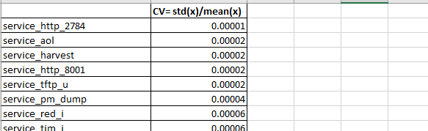
Exploratory Analysis
Looking at the data audit report, num_outbound_cmds has a mean, median, sum as 0. This indicates that all values are 0s. Hence, this variable can be dropped.
Looking at the data audit report, following have mean very close to zero, indicating that a large percentage of values are zero implying that that there is very low variation. These may be dropped.
is_guest_login, is_host_login, land, num_access_files, num_failed_logins, num_shells, root_shell, su_attempted, urgent, num_file_creations, num_root, wrong_fragment
Drop last_flag as this seems to be directly related to attack.
Looking at coefficient of variation report, below variables were dropped:
['dst_host_srv_diff_host_rate','num_compromised','service_X11','service_Z39_50','service_aol','service_auth','service_bgp','service_courier’,
'service_csnet_ns','service_ctf','service_daytime','service_discard','service_domain','service_echo','service_eco_i','service_ecr_i','service_efs’,
'service_exec','service_finger','service_ftp','service_gopher','service_harvest','service_hostnames','service_http_2784','service_http_443’,
'service_http_8001','service_imap4','service_iso_tsap','service_klogin','service_kshell','service_ldap','service_link','service_login','service_mtp’,
'service_name','service_netbios_dgm','service_netbios_ns','service_netbios_ssn','service_netstat','service_nnsp','service_nntp','service_ntp_u’,
'service_other','service_pm_dump','service_pop_2','service_pop_3','service_printer','service_red_i','service_remote_job','service_rje','service_shell’,
'service_sql_net','service_ssh','service_sunrpc','service_supdup','service_systat','service_telnet','service_tftp_u','service_tim_i','service_time’,
'service_urh_i','service_urp_i','service_uucp','service_uucp_path','service_vmnet','service_whois','flag_RSTO','flag_RSTOS0','flag_RSTR','flag_S1’,
'flag_S2','flag_S3','flag_SH']

Slide 6
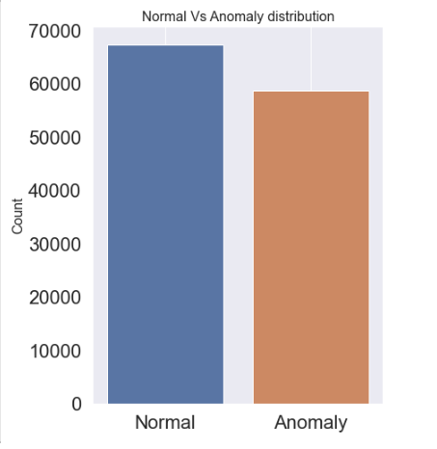
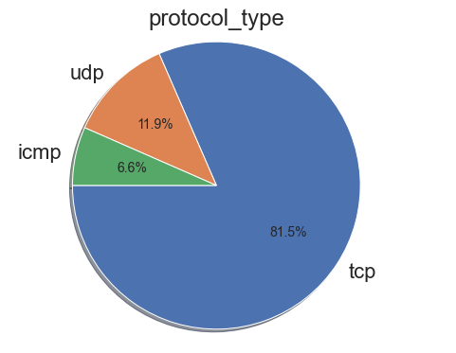
Exploratory Analysis
Maximum type of protocol used during establishing a network connection is TCP.
There is not a marked difference between the number of Normal connections and anomalous connections.

Slide 7
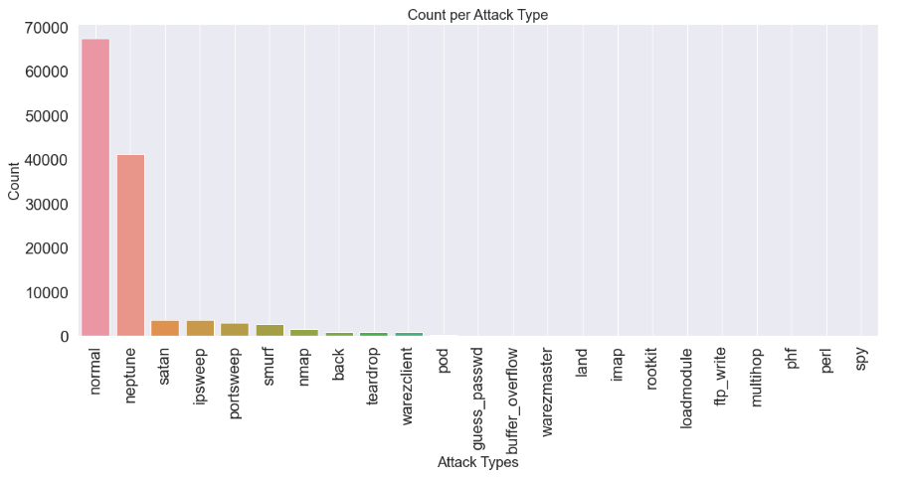
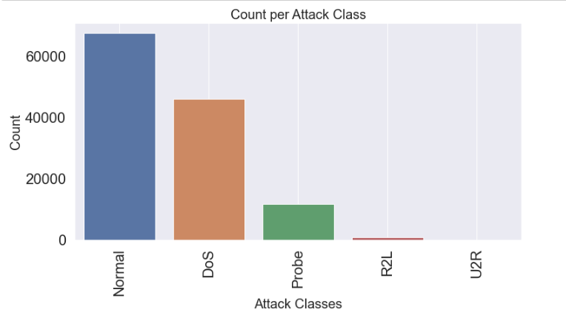
Exploratory Analysis
The maximum number of attack types are categorized as Neptune, followed by Satan.
Denial of service attacks of DoS are most common types of attack class followed by Probe.

Slide 8
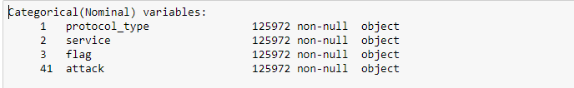
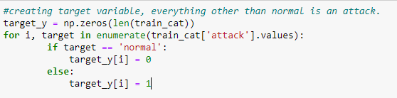
Data audit and preparation
Imported data does not have headers, hence headers were added from the case study details pdf, assuming that the order of the values is same as provided in the pdf.
4 out of 43 variables are categorical, rest are numerical in nature.
Renaming columns appropriately – no name change is required.
Check data types - Done
Check for missing values – no missing values found in train or test data
Apply Outlier treatment -- done for numerical variables.
Check for duplicates – no duplicates found
Any type conversion required - not required
Any special characters that need to removed/replaced – no special characters
Target variable needs to be derived for ‘attack’ variable.
For binomial classification i.e. Normal Vs Anomaly, all values other than normal under attach column are treated as an anomaly.

Slide 9
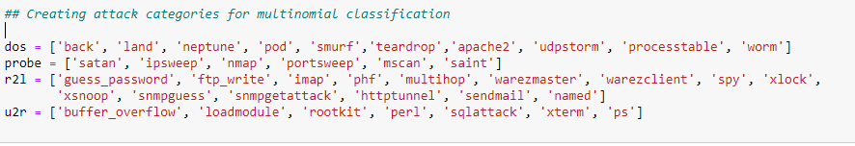
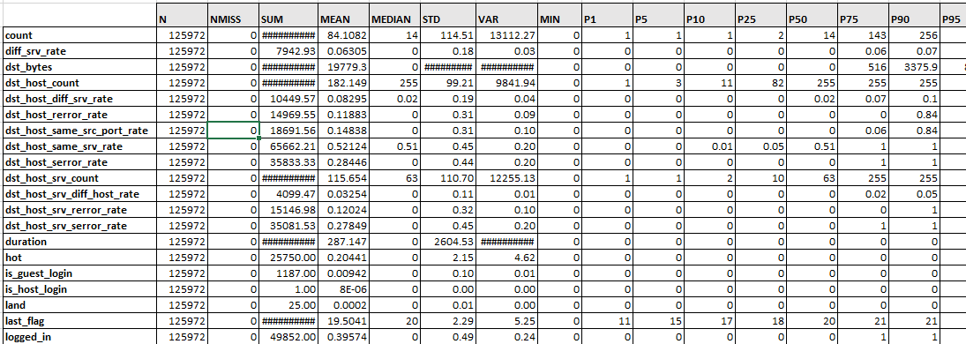
Data audit and preparation
For multinomial classification, attack categories were created as below and ‘attack’ could be dropped.
Created dummies for protocol_type, service, flag variables.
Last_flag variable could be dropped as it is derived from attack variable.
Created data audit report.

Slide 10
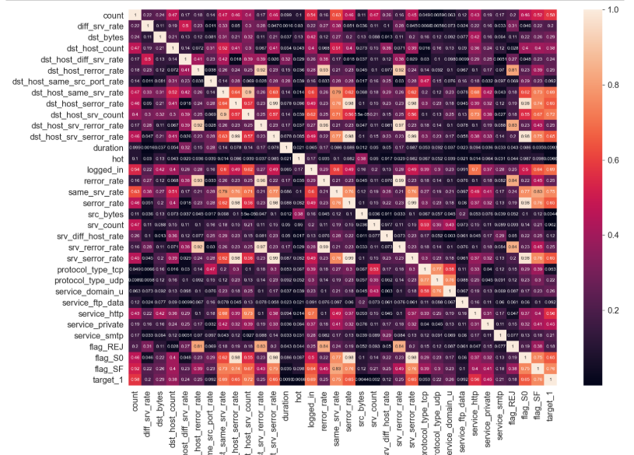
Data audit and preparation
dst_host_rerror_rate is highly correlated with dst_host_srv_rerror_rate, rerror_rate, srv_rerror_rate, flag_REJ
dst_host_serror_rate is highly correlated with dst_host_srv_serror_rate, serror_rate, srv_serror_rate, flag_S0
dst_host_srv_serror_rate is highly correlated with dst_host_serror_rate, serror_rate, srv_serror_rate, flag_S0
Some of these could be dropped.

Slide 11
Feature Engineering
Univariate Regression
VariableName | SomersD
dst_bytes | 0.799057
dst_host_srv_count | 0.784964
same_srv_rate | 0.747816
flag_SF | 0.744312
dst_host_same_srv_rate | 0.730698
diff_srv_rate | 0.689471
logged_in | 0.676629
dst_host_diff_srv_rate | 0.653356
count | 0.641607
dst_host_serror_rate | 0.622378
serror_rate | 0.612409
flag_S0 | 0.583128
srv_serror_rate | 0.578183
dst_host_srv_serror_rate | 0.566805
service_http | 0.52597
Random Forest ranking
feature | importance
src_bytes | 0.239264
flag_SF | 0.124855
dst_host_same_srv_rate | 0.115131
dst_bytes | 0.101696
diff_srv_rate | 0.073738
dst_host_srv_count | 0.069438
logged_in | 0.054344
count | 0.023756
dst_host_count | 0.022534
protocol_type_tcp | 0.021949
dst_host_same_src_port_rate | 0.017292
same_srv_rate | 0.015534
srv_count | 0.015086
service_private | 0.011454
dst_host_diff_srv_rate | 0.01112
RFE
Important Features
count
diff_srv_rate
dst_bytes
dst_host_count
dst_host_diff_srv_rate
dst_host_rerror_rate
dst_host_same_src_port_rate
dst_host_same_srv_rate
dst_host_serror_rate
dst_host_srv_count
flag_SF
hot
protocol_type_tcp
src_bytes
srv_count
Input to VIF
srv_serror_rate
dst_host_diff_srv_rate
serror_rate
same_srv_rate
hot
logged_in
dst_host_serror_rate
flag_SF
protocol_type_tcp
dst_host_same_srv_rate
dst_host_same_src_port_rate
count
dst_host_rerror_rate
dst_host_count
src_bytes
service_http
service_private
dst_bytes
dst_host_srv_count
flag_S0
dst_host_srv_serror_rate
diff_srv_rate
srv_count
There were combinations of univariate regression, RFE, Kbest, Random forest that were tried to see the outcome on the models. Individual outputs of features were also tried in combination with VIF. The above combination worked out best.

Slide 12
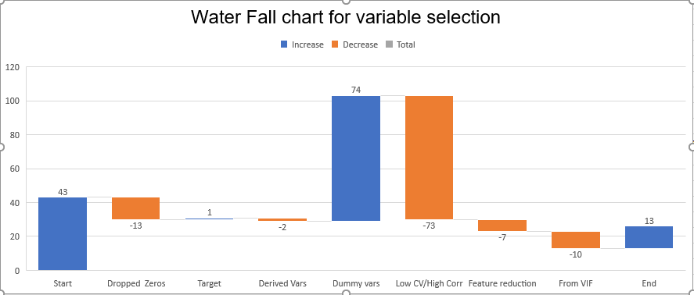
Feature Engineering
Started with 43 variables
Dropped 14 variables as almost all values were zeros
Dropped last_flag as this seems to be directly related to class
Created target variable and dropped attack.
Created dummy variables for categorical variables
Dropped as coefficient of variance less than 0.04 or high correlation of over 0.8
Select 15 best from RFE, RF and Univariate regression each. Intersection gave a list of 23 important features
Comparison with VIF gave the finalized list of 13 features
Final list of features
No. | VIF_Factor | features
1 | 4.971354 | count
2 | 4.274877 | dst_host_srv_count
3 | 3.858464 | logged_in
4 | 3.109039 | srv_count
5 | 2.976044 | dst_host_serror_rate
6 | 2.117948 | dst_host_diff_srv_rate
7 | 1.874225 | dst_host_rerror_rate
8 | 1.600401 | diff_srv_rate
9 | 1.515032 | service_private
10 | 1.394595 | dst_bytes
11 | 1.373448 | dst_host_same_src_port_rate
12 | 1.243505 | hot
13 | 1.230674 | src_bytes

Slide 13
Model building and execution
Below models were executed:
Logit classification
Logistic Regression using sklearn
Random Forest Classification
Xtreme Gradient Boost Classification
K-Nearest Neighbors Classification
Ada Boost Classification
Naive Bayes Classification
Train data(train.csv) and test data(test.csv) were provided separately. Hence, model was built an provided train and validating against the test data.
For binomial classification, Logit classification, Logistic Regression using sklearn, Random Forest Classification, K-Nearest Neighbors Classification and Bernoulli Naive Bayes classification was used and were compared for accuracy and AUC scores.
For multinomial classification, Gaussion Naive Bayes classification, Random Forest Classification and Xtreme Gradient Boost Classification were used and were compared for accuracy and AUC scores.
Using SVR with GridSearchCV or KNN with GridSearchCV or XGBoost with GridSearchCV, even with 80 to 120 models caused the machine to hang or run on for hours (ultimately the process was killed).
Model was validated with ROC curves and cross validation.
Baseline done with scikit-learn’s DummyClassifier for both bionomial and multinomial classification.

Slide 14
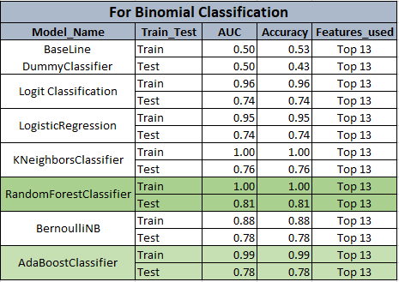
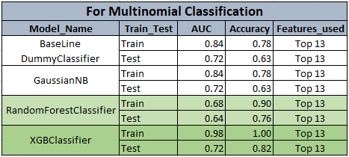
Model comparison
Final Model for Binomial classification for categorizing against Normal or Abnormal is RandomForestClassifier. All models have overfitting issues but comparing the AUC and Accuracy across binomial models the above is the best one.
Final Model for Multinomial classification for categorizing into DoS, Probe, R2L, U2R is XGBClassifier. All models have overfitting issues but comparing the AUC(overall and individual classes) and Accuracy across multinomial models the above is the best one.
Best Parameters for the chosen models:
RandomForestClassifier:
max_depth=16, max_features=10, n_estimators=90, bootstrap=True, n_jobs=None, min_samples_leaf=1, CV=5
XGBRegressor:
learning_rate=0.5, max_delta_step=0, max_depth=5,
min_child_weight=1, gamma=1, n_estimators=1000, n_jobs=-1

Slide 15
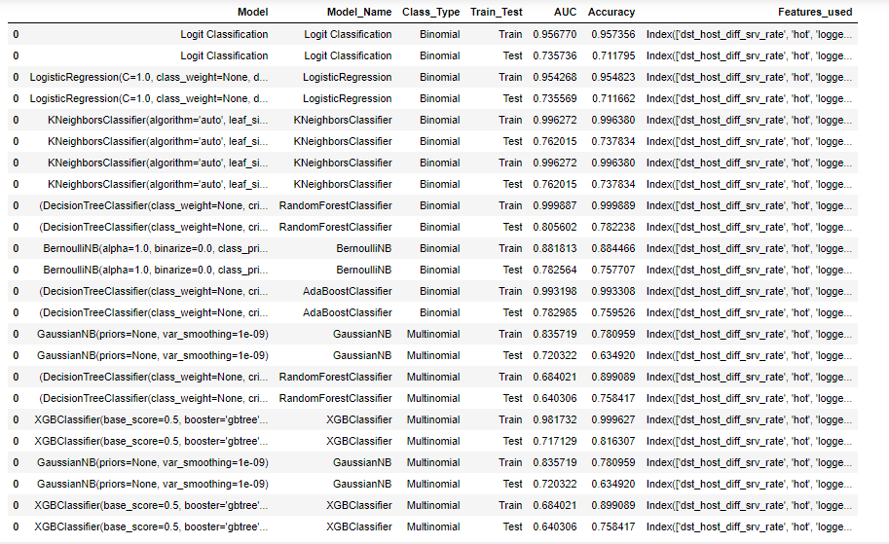
Model comparison
Some of the models that were tried with different parameters.

Slide 16
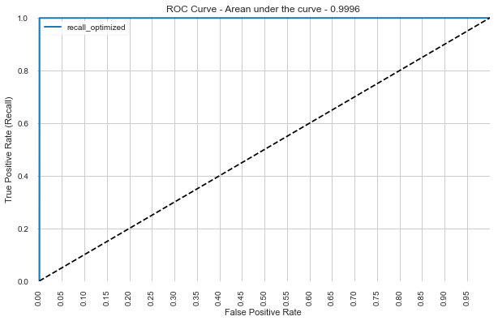
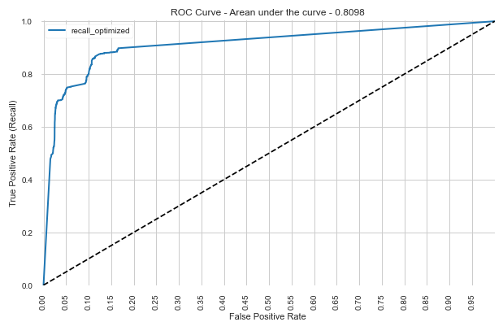
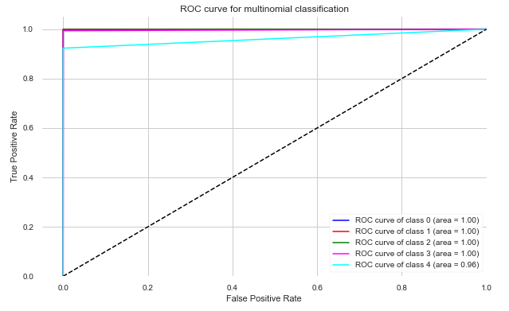
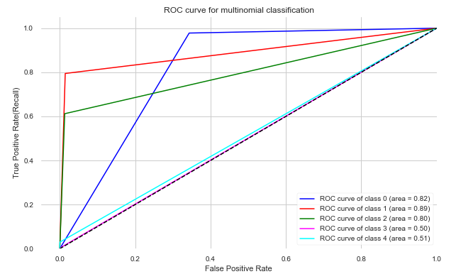
Model comparison
Train Data
Test Data
Random Forest Classifier
Binomial Classification
XGBoost Classifier
Multinomial Classification

Slide 17
Predict on data
For prediction on new data:
All data manipulation steps would apply as in this case study including missing treatment and outlier treatment for both binomial and multinomial classification.
All derived variable would need to be created for both binomial and multinomial classification.
All dummy variable creation steps would apply.
Key differences when treating the binomial and multinomial classification:
For binomial, attack variable was reduced to a normal Vs anomaly binary variable and then further reduced to encoded variable with positives as anomalies.
For multinomial, attack variable was changed to target nominal variable of type int having the attack class categories.
For multinomial predictions, the models were fed with label binarized target – the target (y_true) was modified into n(tyes of classes) Dimensional array.
Also, for calculations of the ROC AUC for multinomial classification, the predictions were also label binarized.
Final models were saved into pickle object.

Slide 18
Thank You !

